Slide 1
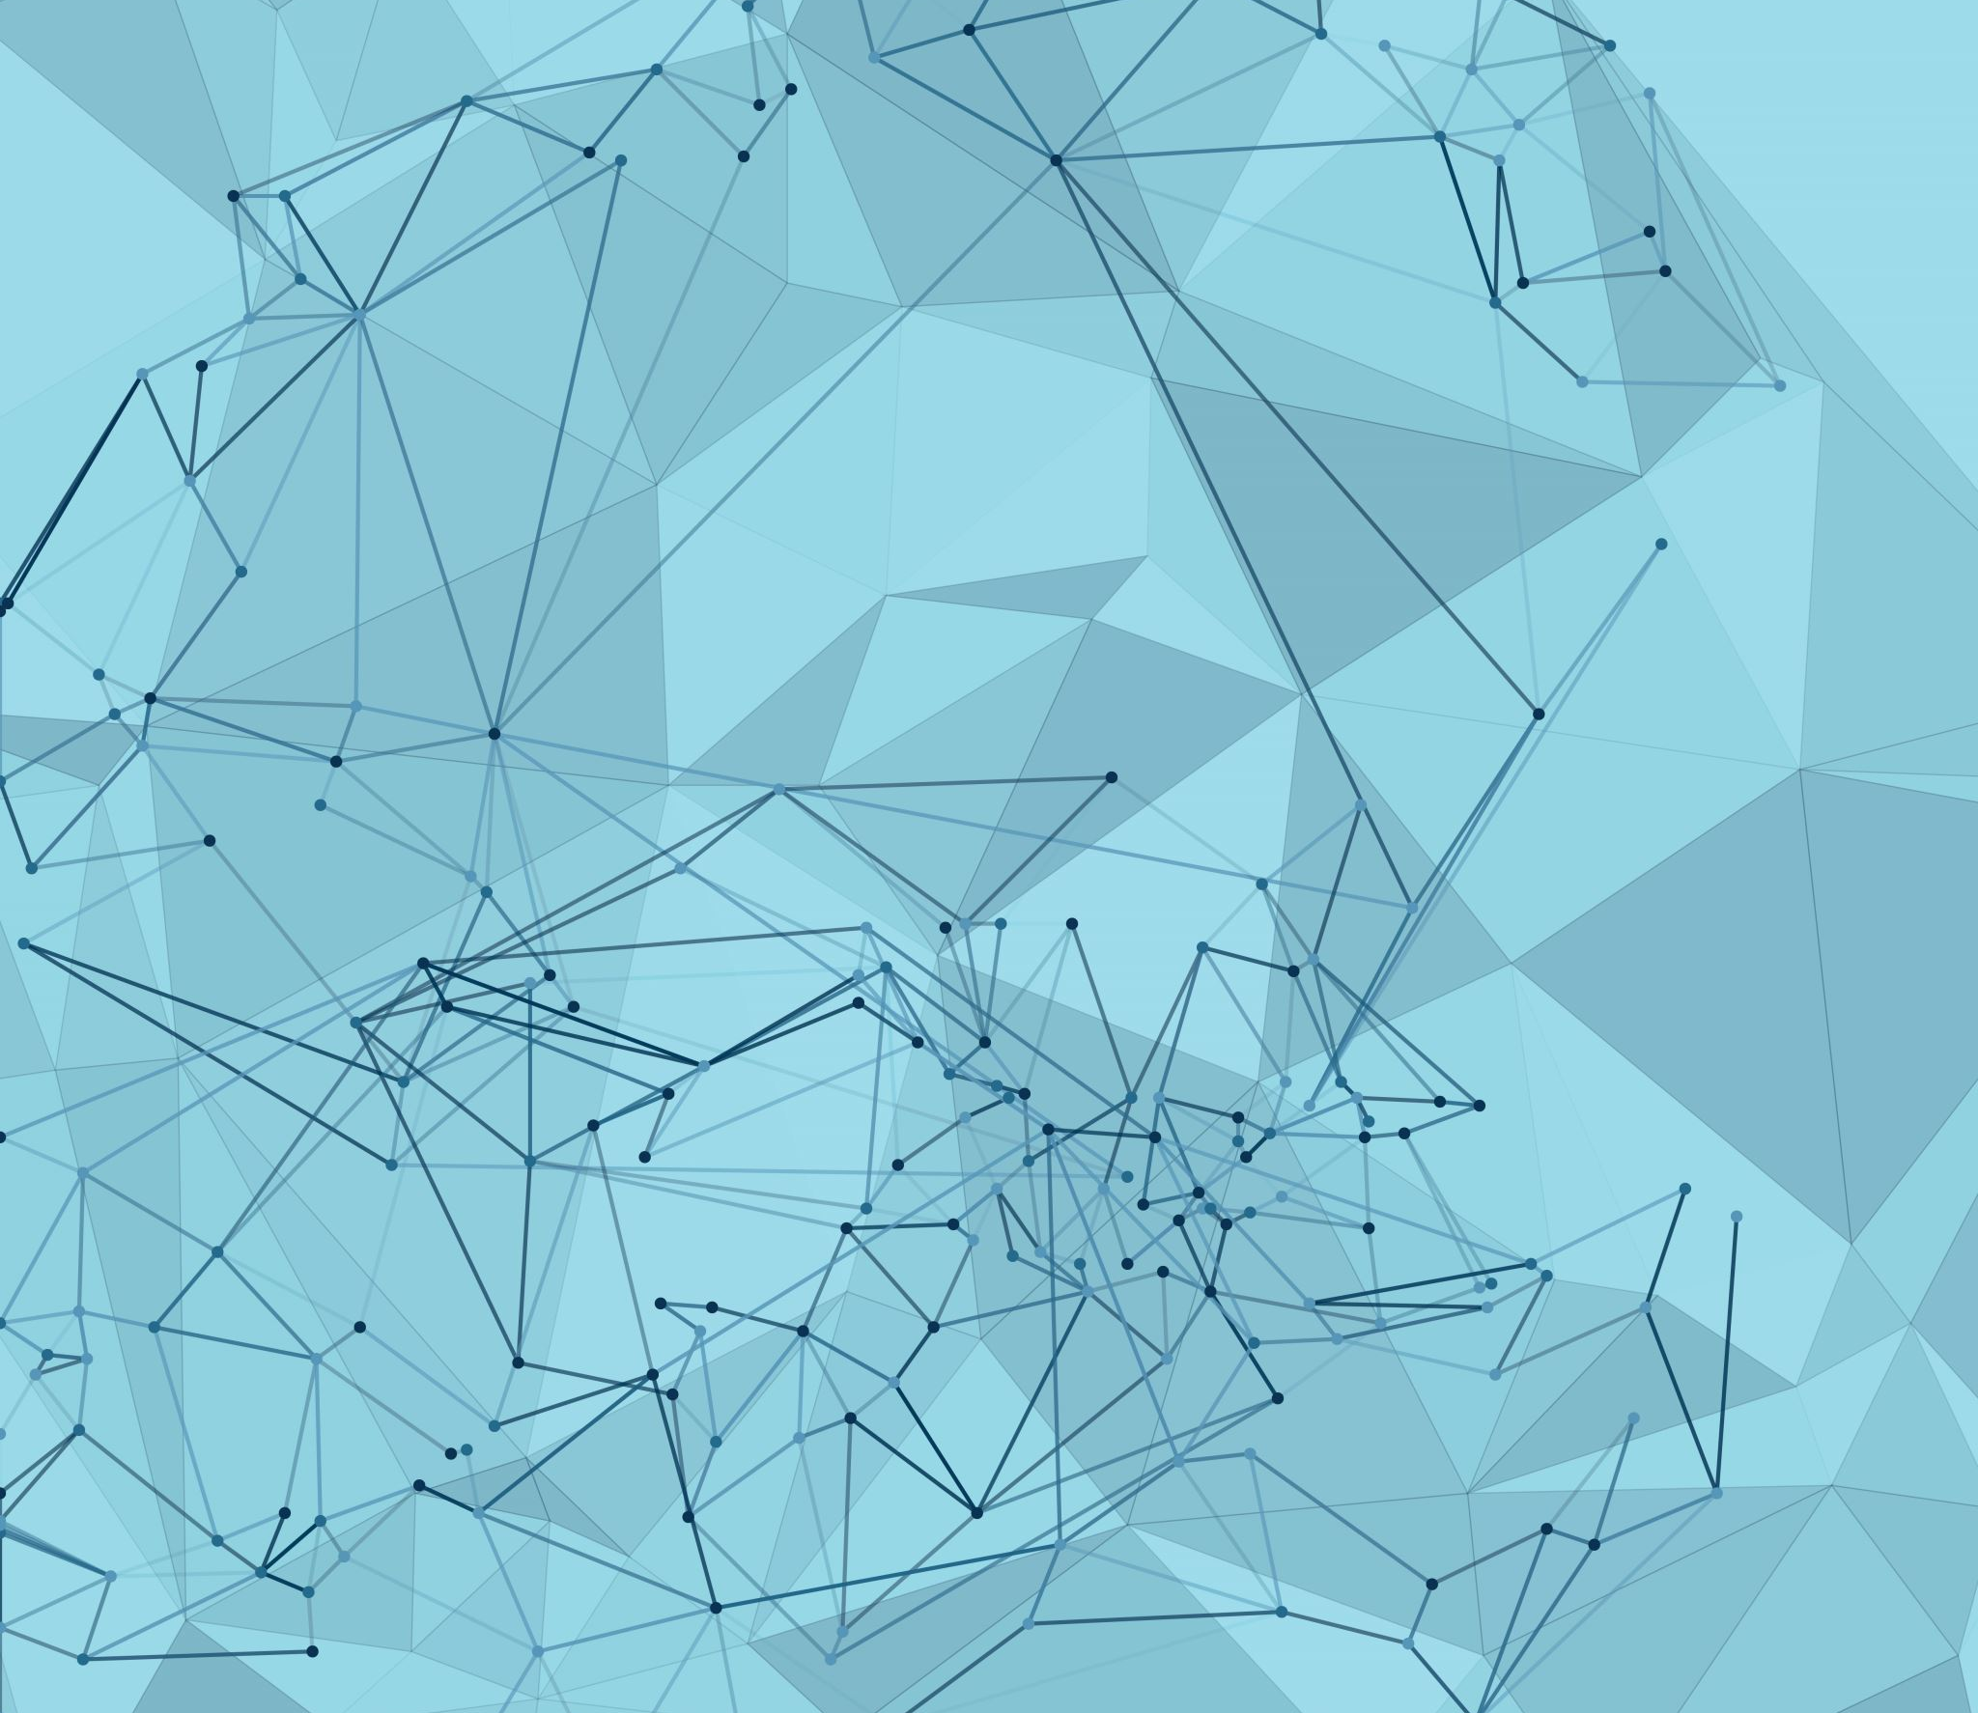
Uni-TAGGER: A U.I. FOR ALPHAFOLD EVALUATION OF RECOMBINANT TAG- INDUCED CONFORMATIONAL SHIFTING
CHRIS KONG & HENRY SCOTT
BP219: FALL 2022

Slide 2



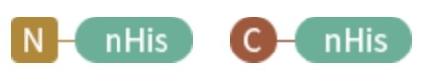


Problem: protein affinity/fusion tags…necessary- but can represent blackboxes
How do I choose the right tag?
I picked the right tag and have my construct design!
Purification and Experimentation
Where’d my protein go!?
Why is my protein acting so abnormally ???
Solution: Uni-Tagger

Slide 3

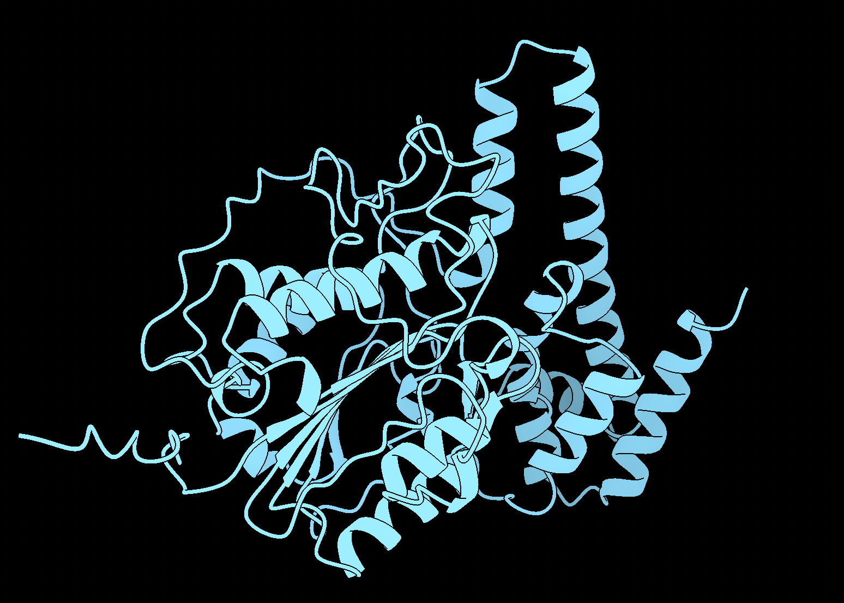
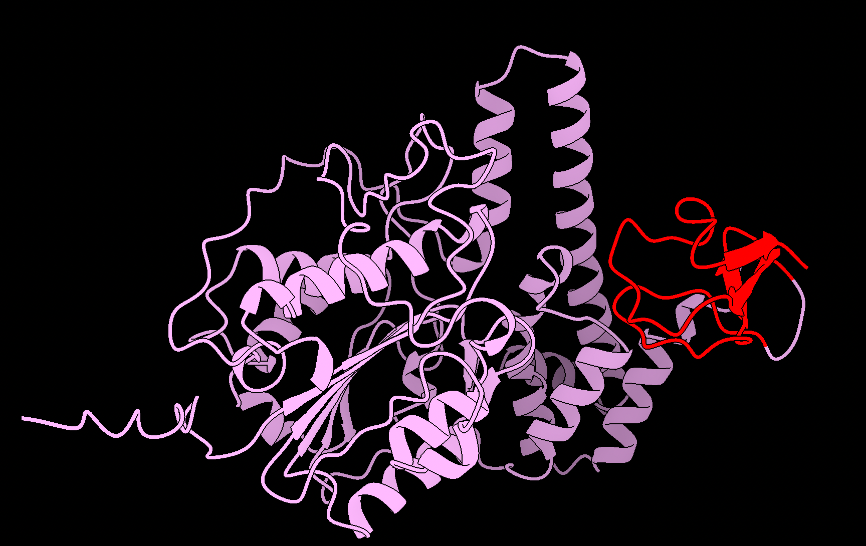
Uni-Tagger: A UI for evaluation of conformational changes to native structure induced by the
introduction of a recombinant tag or fusion protein.
Protein
Protein-tag
&
base operation
Functionality
Where:
Alphafold2
structure prediction
= native protein
Parallel evaluation of multiple tags
UI grad.io
= tags
Parallel evaluation of multiple proteins
Rigid-body alignment of resultant structure predictions
Biopython
RMSD measurement of aligned protein vs protein-tag
output
aligned .pdb coordinates
graph(s) of global RMSD values
Notes:
Logic: By comparing structure predictions of native protein Vs. protein-tag maybe we can spot probable

Slide 4
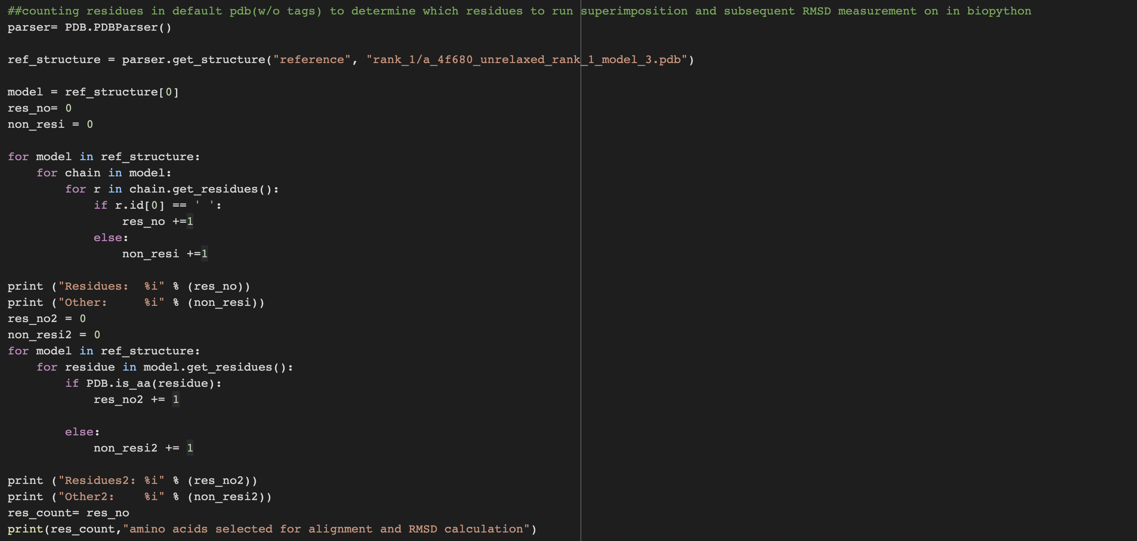
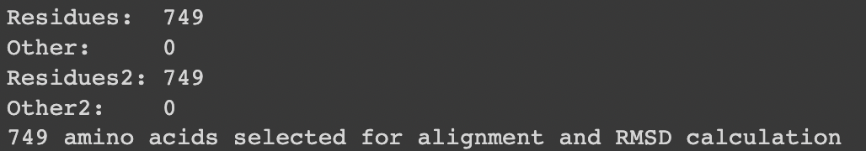
AlphaFold2 predictions-> PDB alignments and RMSD calculation: Biopython
Counting the number of AA reference
structure and residues to be used in RMSD calc.
Assigning the calculated count to an object I can call for RMSD calc and printing the count for a double check
output

Slide 5
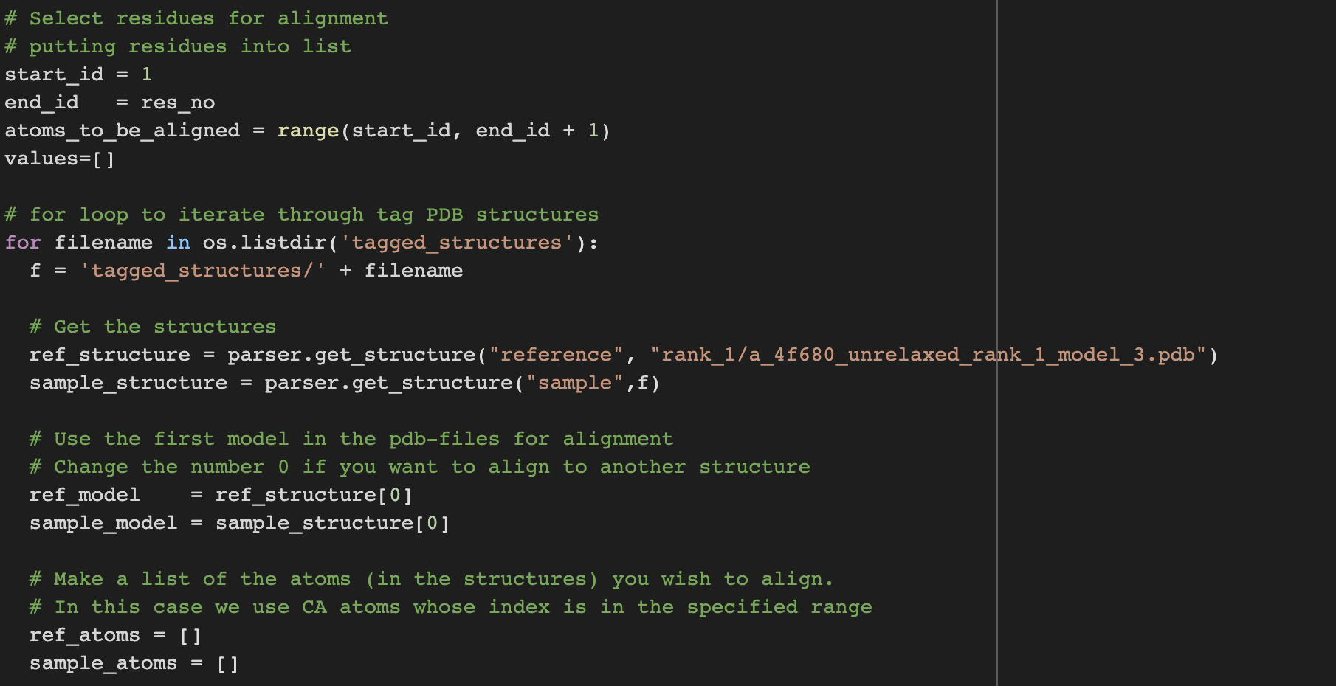
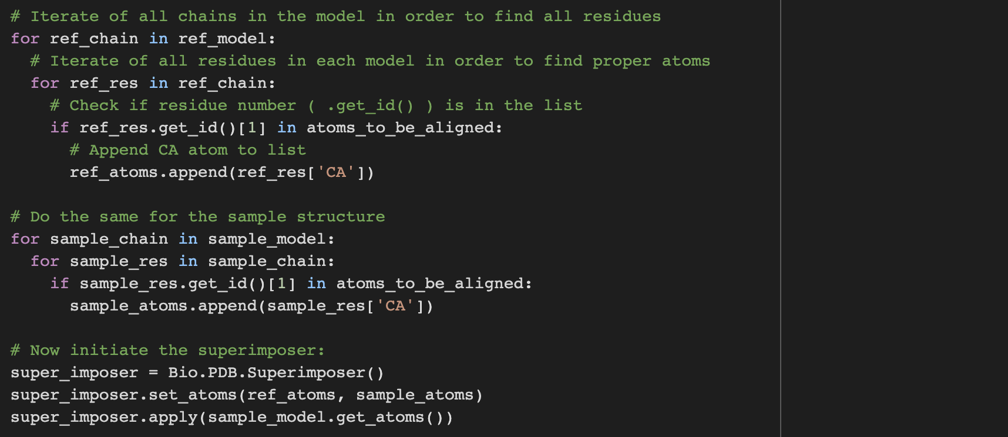
AlphaFold2 predictions-> PDB alignments and RMSD calculation: Biopython
Assigning the range of residues to be used for RMSD calc.
Iterating through multiple tag variant alphafold predictions for the same base protein
setting variables for alignment
Running fixed body alignment algo with Bio.PDB.Superimposer
https://gist.github.com/andersx/6354971
Notes:
Superimposer algorithm calculates translation and rotation matrix that rotates the reference and tagged structure such that their RMSD is minimized using singular value decomposition

Slide 6
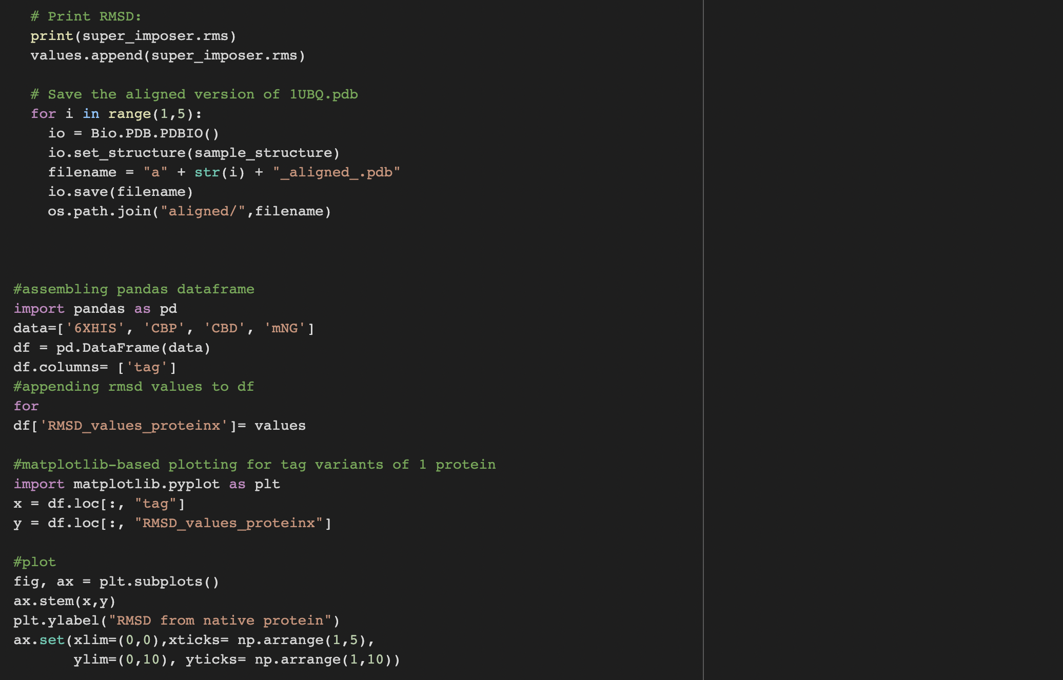
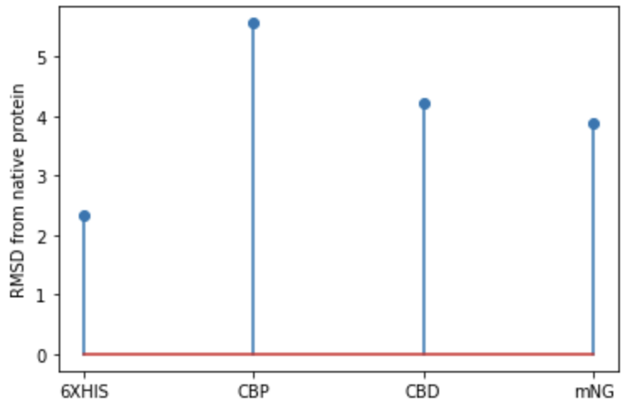
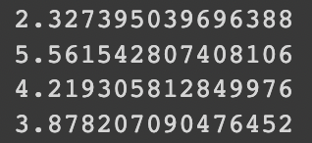
AlphaFold2 predictions-> PDB alignments and RMSD calculation: Biopython
Appending calculated RMSD values to list for plotting
generating and saving .pdb file for aligned tag structures
Proof of Concept Plotting
output

Slide 7


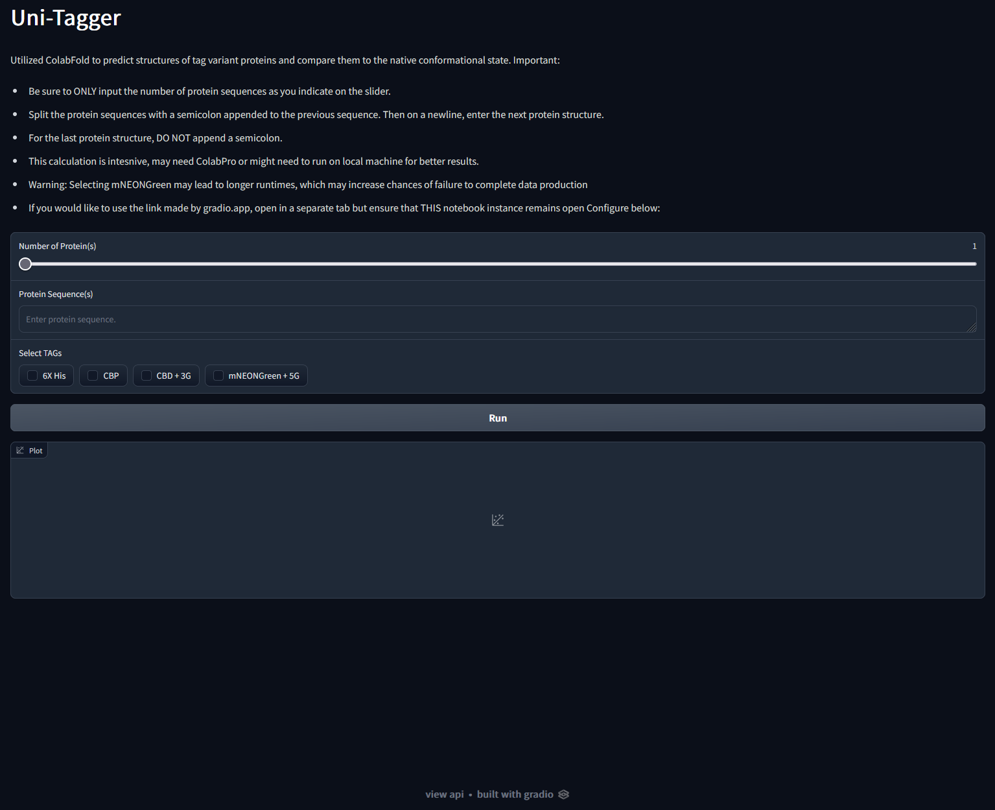

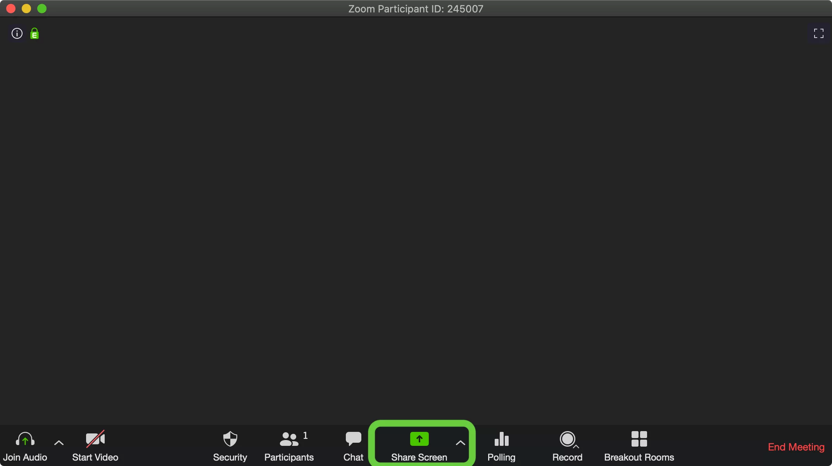


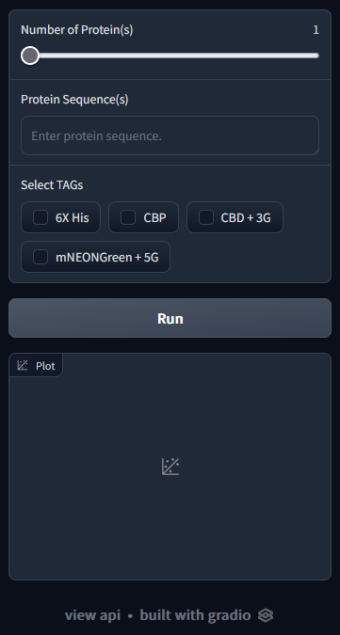
User Interface: Never judge a book (interface) by its cover
Purpose:
Incorporate a front-end/back-end implementation
Very intuitive, simple design
Universal device

Slide 8
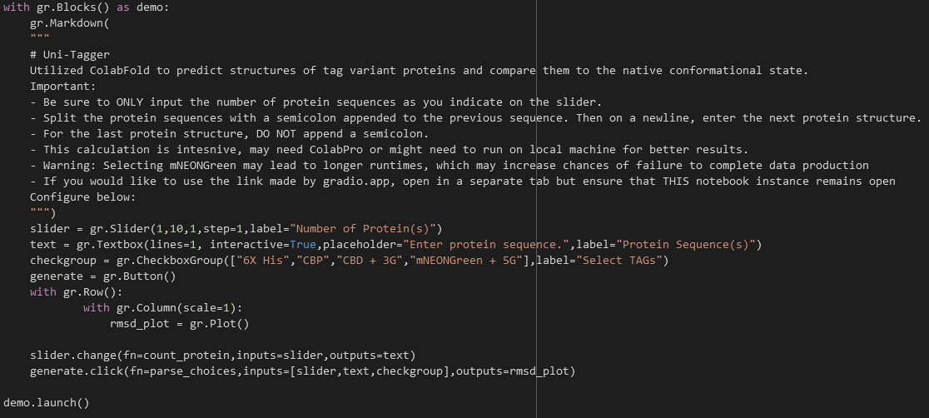
User Interface: Never judge a book (interface) by its cover

Slide 9
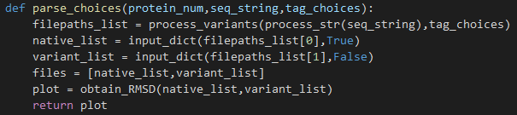
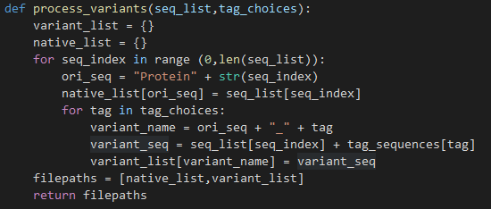
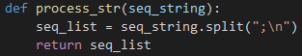
User Interface: Never judge a book (interface) by its cover
“How do I specify the amount of protein sequences?”
“How do I get the aligned variant pdb(s)… what about the RMSD plot(s)?
“How do I generate all variants and store them?”
“How can I process the sequences given?”

Slide 10
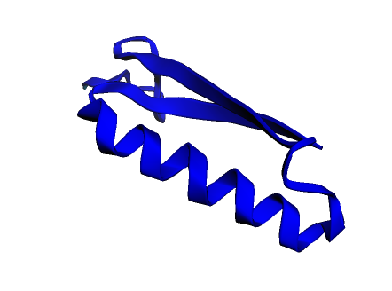



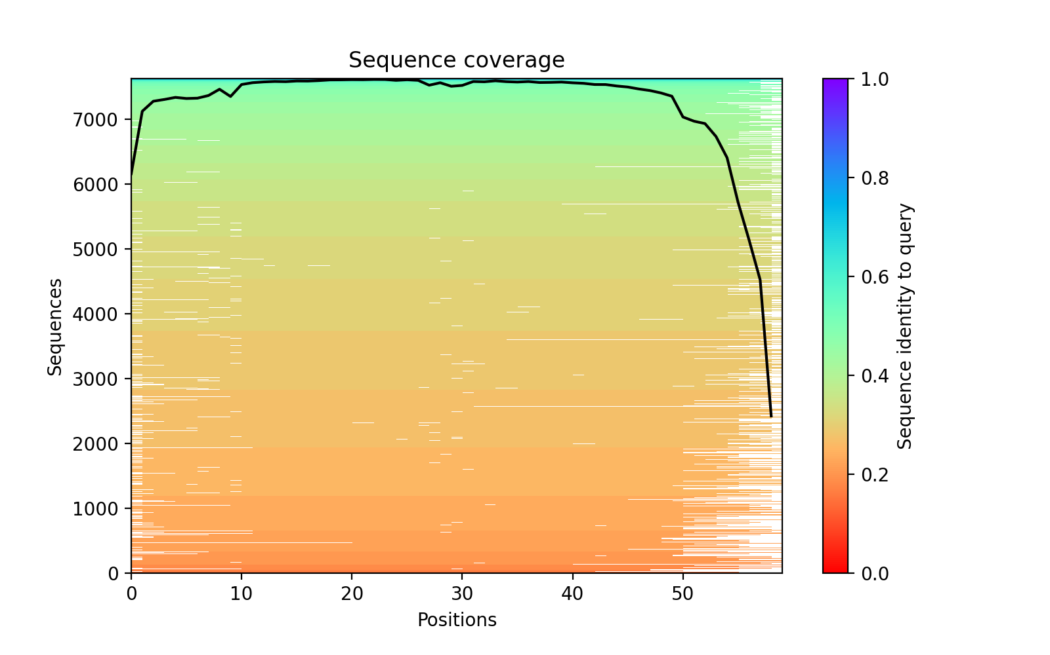
Structure Prediction: Go fetch! Now fetch again…
Now that I have all these sequences, how can I iterate through all of them and obtain the structures?
XXXXXXXXXX…CBP
XXXXXXXXXXX…His
XXXXXXXXXX…CBP
XXXXXXXXXXX…His
ColabFold
(AlphaFold Structure Prediction)
Best Ranked PDB
Native and Tag Variant
Sequences

Slide 11
Structure Prediction: Go fetch! Now fetch again…
Similarities | Differences
Install Dependencies Import Modules/Packages Prediction Callback Run Prediction | Sequence input -> dictionary of inputs Save locally in the colab notebook Separation of best ranked PDB Returning a reference to the filepaths

Slide 12

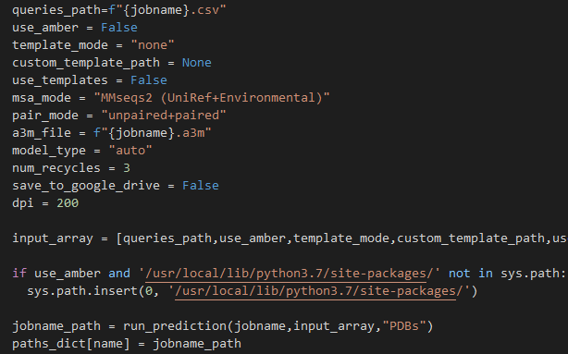
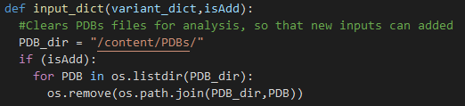
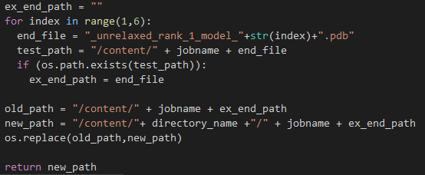
Structure Prediction: Go fetch! Now fetch again…
How do I
calculate RMSDs?
“What parameters are you sending to AF2?”
“Where are PDBs stored?”
“How do you select for best ranked PDBs?”

Slide 13

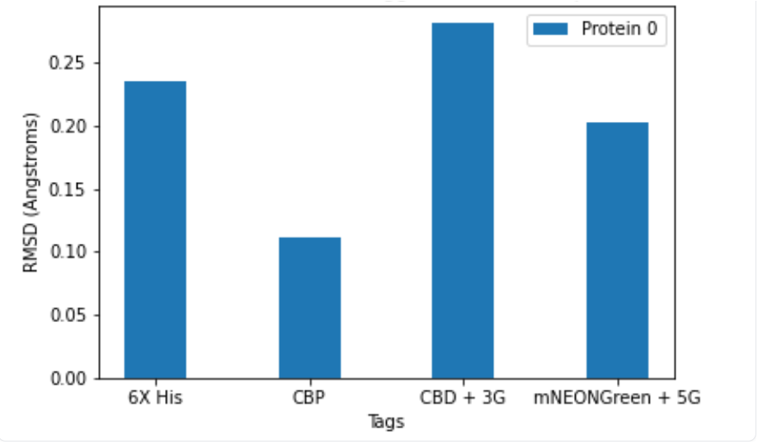
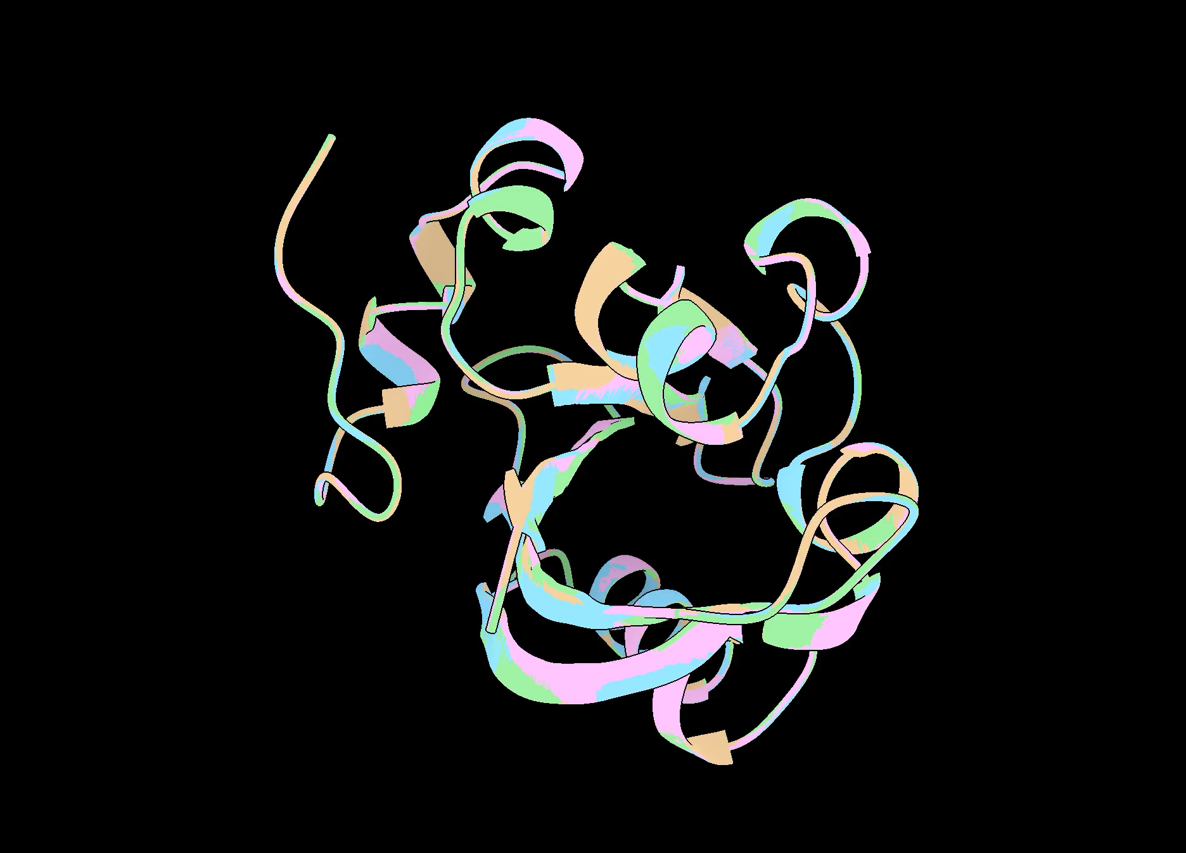
Output
Manual structure inspection
FASTA sequence for PDBID: 2ZOI
(Photoactive Yellow Protein)
aligned .PDB files for tag variants
Uni-Tagger

Slide 14
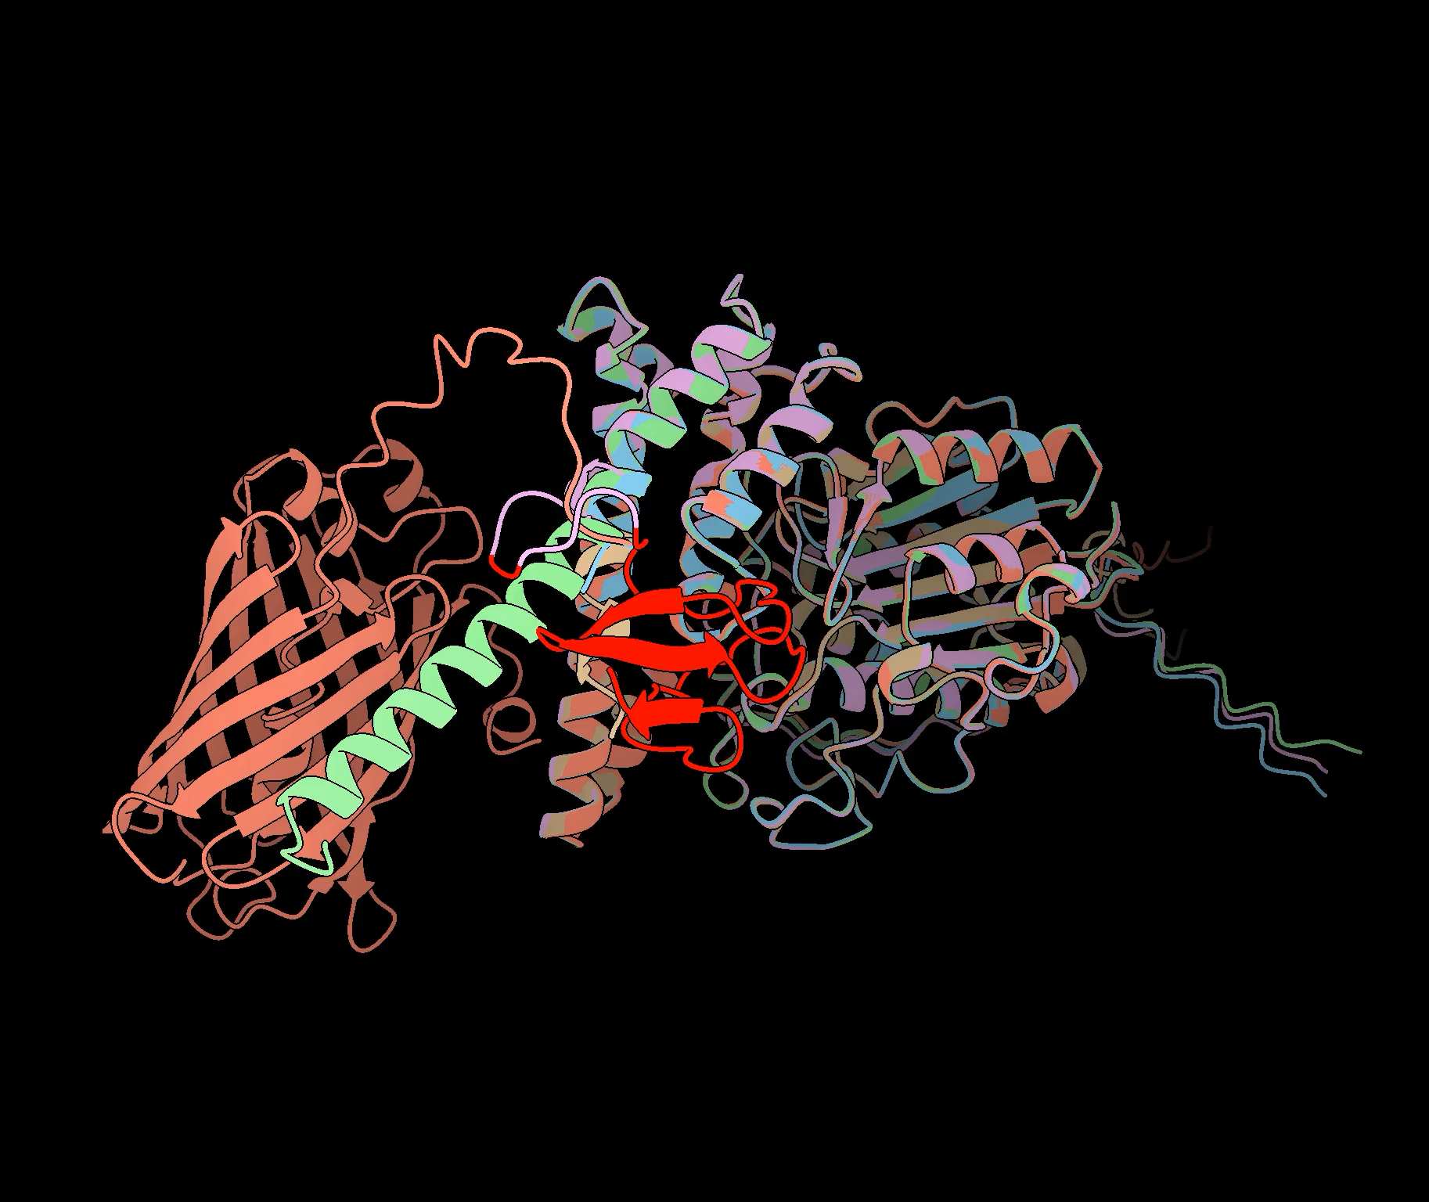
The End Product: INSIGHT
1CJY
HUMAN CYTOSOLIC PHOSPHOLIPASE A2
Deposited PDB
Deposited PDB-6XHIS
Deposited PDB-CBP
Deposited PDB-CBD
Deposited PDB-mNG

Slide 15

Future Directions
AlphaFold2 Functionality to run in parallel?
Expanding tag variant library
Screen if sequence is in PDB database… if so, what can I do to manipulate it?
Display alignment in UI (pymol)
Evaluating tag effect on known multimerization
Generating per-residue RMSD scoring function

Slide 16

Questions?

